Slide 1
Mobile App Usage Trends

Slide 2
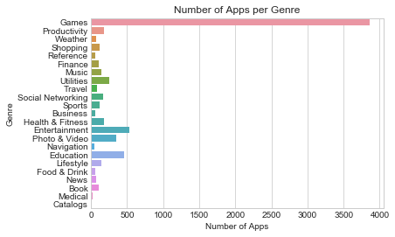
Mobile App Data

Slide 3
Assumptions:
This data has been collected from the iTunes Search API from the Apple Store.
The data has been gathered correctly with no biases.
There may be overlaps between genres that have not been addressed.

Slide 5
Most Popular Apps by Genre
Genre App Name
Book Kindle
Business Indeed Job Search
Catalogs CPlus for Craigslist app
Education Duolingo
Entertainment Netflix
Finance Chase Mobile
Food & Drink Starbucks
Games Clash of Clans
Health & Fitness MyFitnessPal
Lifestyle Zillow Real Estate
Medical Baby Connect (Activity Log) $4.99
Music Pandora - Music & Radio
Genre App Name
Navigation Waze
News Twitter
Photo & Video Instagram
Productivity Evernote
Reference Bible
Shopping Groupon
Social Facebook
Networking
Sports ESPN
Travel Google Earth
Utilities Google
Weather The Weather Channel

Slide 6


Slide 7
Free Vs Paid Apps

Slide 9
Findings
Number of screenshots help to not only get better visibility, but also get rated higher by users.
This is most commonly seen for genres like Games, Education, Photo & Video, Shopping, Music, Productivity, Health & Fitness, Lifestyle and Entertainment.
Price plays an important role for genres like Games, Productivity, Weather, Health & Fitness and News.
Number of supported devices played an important role in making apps for Entertainment, Photo & Video and Education popular.
Number of languages supported had most positive influence on Weather, Utilities and Games apps.

Slide 10
What’s next..
Language classification.
Get data for genres like catalog, medical, navigation, business, etc – addressed by splitting dataset into Games and non-Games datasets.
Correlation between user rating and user rating for current version.

